Slide 1
Multi-image captioning
2020-03-06

Slide 2
Pre-requisite reading
Required
Show attend and tell: https://arxiv.org/abs/1502.03044 (Or any other image caption generation paper)
REINFORCE: https://link.springer.com/content/pdf/10.1007%2FBF00992696.pdf
Recommended, but not required
Deep sets: https://arxiv.org/abs/1703.06114

Slide 3
Problem definition
Input: a set of images {I₁, …, I_{n}}, where n is not fixed
Output: a single natural language sentence summarizing all inputs
It’s possible to “overlook” certain images for “maximal” summarization
Ideally, it should generalize over the objects in the images : {“dog on a table”, “cat on a chair”} → “animal on a furniture” : but this is likely to be very difficult (requires external knowledge source) : so we’ll try to avoid language hierarchy-related datasets

Slide 4



Overall architecture
The architecture should be permutation invariant with respect to the input, meaning the output should unchanged after mixing the order of the input images.
Deep set (NeurIPS 2019) provides a form of a permutation invariant function:
$$f\left(\sum_{i}{φ\left(x_{i}\right)}\right)$$
x₁
x₂
$$∑$$
f
Output sentence
$$φ(⋅)$$
……
x_{N}

Slide 5



Architecture explanation
Individual image encoder (red)
Roughly speaking, this is where we’re creating a “meta image”
An ideally generated meta image will contain abstract intersection info.
Caption generation (green)
Generate a caption based on the meta image
Although the meta image is not human-readable, we hope the caption generator to be able to capture the essence
$$f\left(\sum_{i}{φ\left(x_{i}\right)}\right)$$
x₁
x₂
$$∑$$
f
Output sentence
$$φ(⋅)$$
……
x_{N}

Slide 6
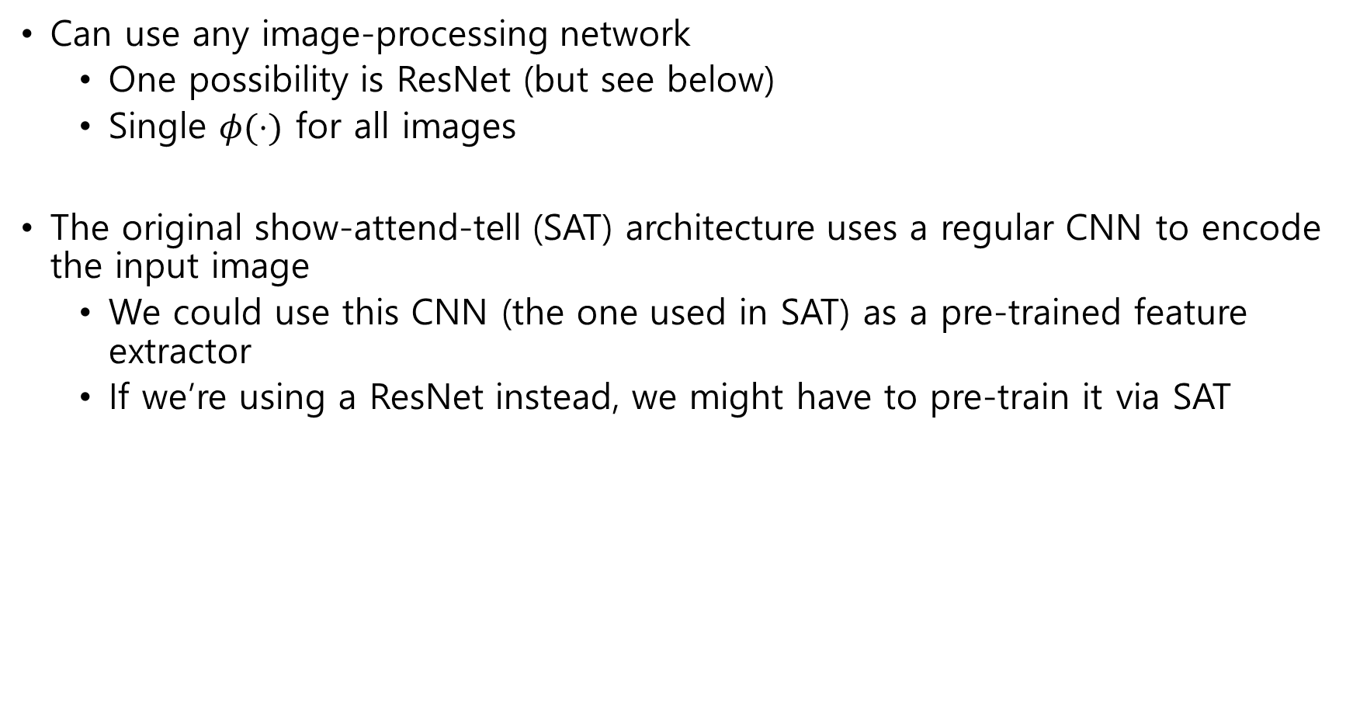
Feature extraction architecture $φ(⋅)$
Can use any image-processing network
One possibility is ResNet (but see below)
Single $φ(⋅)$ for all images
The original show-attend-tell (SAT) architecture uses a regular CNN to encode the input image
We could use this CNN (the one used in SAT) as a pre-trained feature extractor
If we’re using a ResNet instead, we might have to pre-train it via SAT

Slide 7
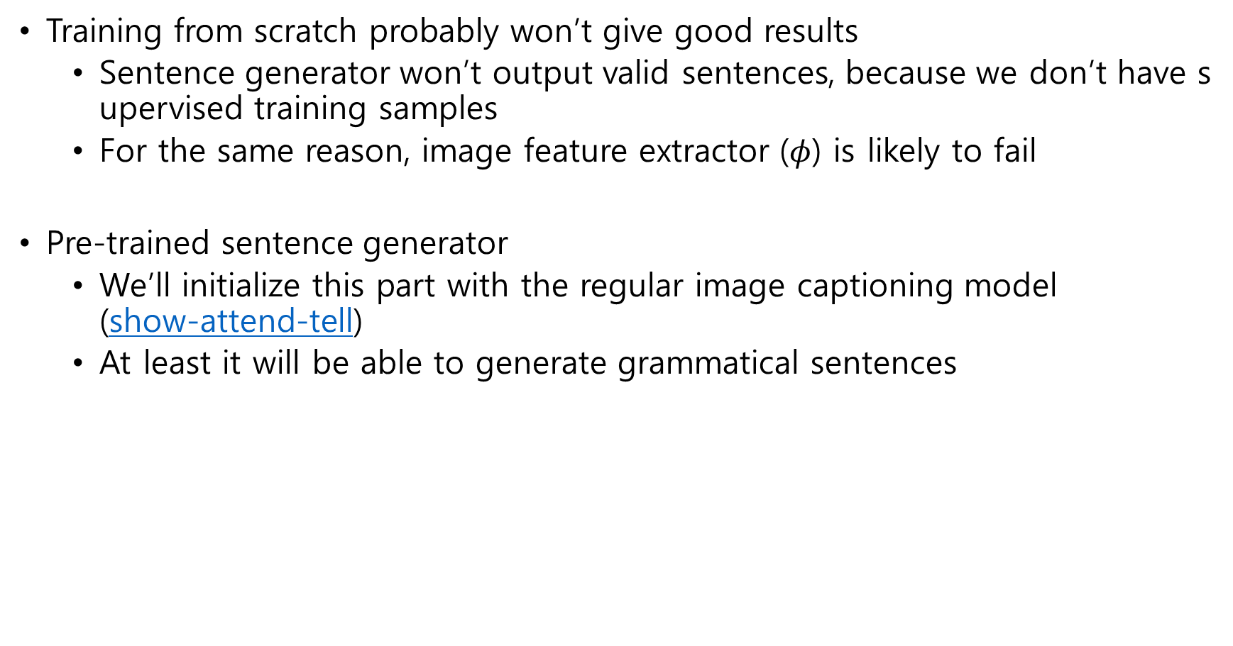
Pre-training strategies
Training from scratch probably won’t give good results
Sentence generator won’t output valid sentences, because we don’t have supervised training samples
For the same reason, image feature extractor ($φ$) is likely to fail
Pre-trained sentence generator
We’ll initialize this part with the regular image captioning model (show-attend-tell)
At least it will be able to generate grammatical sentences

Slide 8





Training
Training criterion
The generated caption should be compatible with as many images in the input set as possible
How do we measure compatibility?
Train another NN for compatibility
I already did this!
A NN that takes a sentence and an image
And outputs a value between 0 and 1 (1 being perfect match)
Of course this is somewhat fragile, but it’ll have to do for now
I₁
$$S\left(t,I_{1}\right)=1$$
$$S\left(t,I_{2}\right)=1$$
I₂
t=“Round shape next to a quadrilateral”
$$S\left(t,I_{3}\right)=1$$
3 out of 4 compatible
I₃
$$S\left(t,I_{4}\right)=0.5$$
$$S\left(t,I_{i}\right)$$
I₄

Slide 9
Training
New objective
Train the caption generator so that the generated caption is maximally compatible with the image set
i.e., the training signal (=reward) becomes the product of all compatibilities
Unfortunately, the training signal is non-differentiable w.r.t. the parameters
Can’t apply gradient descent
Reinforcement learning techniques can deal with non-differentiable rewards
We’ll use REINFORCE, in particular

Slide 10
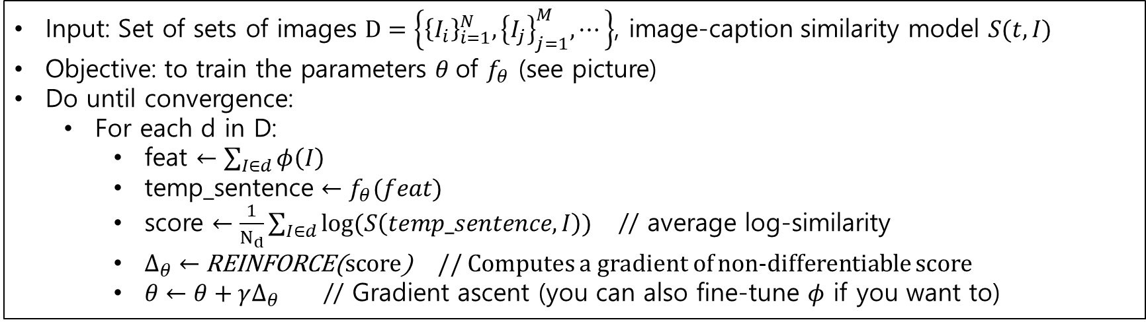

Training (continued)
Pseudocode
Input: Set of sets of images $D=\left\{{\left\{I_{i}\right\}}_{i=1}^{N}, {\left\{I_{j}\right\}}_{j=1}^{M}, ⋯\right\}$, image-caption similarity model $S(t, I)$
Objective: to train the parameters $θ$of $f_{θ}$ (see picture)
Do until convergence:
For each d in D:
feat $←\sum_{I∈d}{φ\left(I\right)}$
temp_sentence $←f_{θ}(feat)$
score $←\frac{1}{N_{d}}\sum_{I∈d}{log⁡(S\left(temp_sentence, I\right))}$ // average log-similarity
$Δ_{θ}←$ REINFORCE(score) // Computes a gradient of non-differentiable score
$θ←θ+γΔ_{θ}$ // Gradient ascent (you can also fine-tune $φ$ if you want to)
x₁
x₂
$$∑$$
$$f_{θ}$$
Output sentence
$$φ(⋅)$$
……
x_{N}

Slide 11
Etc.
To generate a caption for a given image set, we simply do a forward pass
Concerns
Very slow convergence, if pre-training not properly done
REINFORCE has very high variance. Might have to test a different policy gradient algorithm (perhaps Actor-critic?)
After summing the input image features, should we average them? Probably so…

